Slide 1
PAI Group 2 Presentation
Quah Johnnie (2007476),
Jayden Yap (2112790),
Bey Wee Loon (2112802)

Slide 2
Tables of Contents
Section | Remarks
Introduction | -
Week 12 & 13 | Product Backlog, Data-Preprocessing, Outlier Detection, Feature Engineering, Addressing Multi-Collinearity Issues, Setting up MLFlow
Week 14 & 15 | Feature Selection, Evaluating Outlier Detection Methods, Testing Sampling Methods, Model Comparison, Hyperparameter Tuning
Week 16 & 17 | Creating Tkinter GUI, Testing and Deployment of Executable file. Project documentation
Summary | -

Slide 3
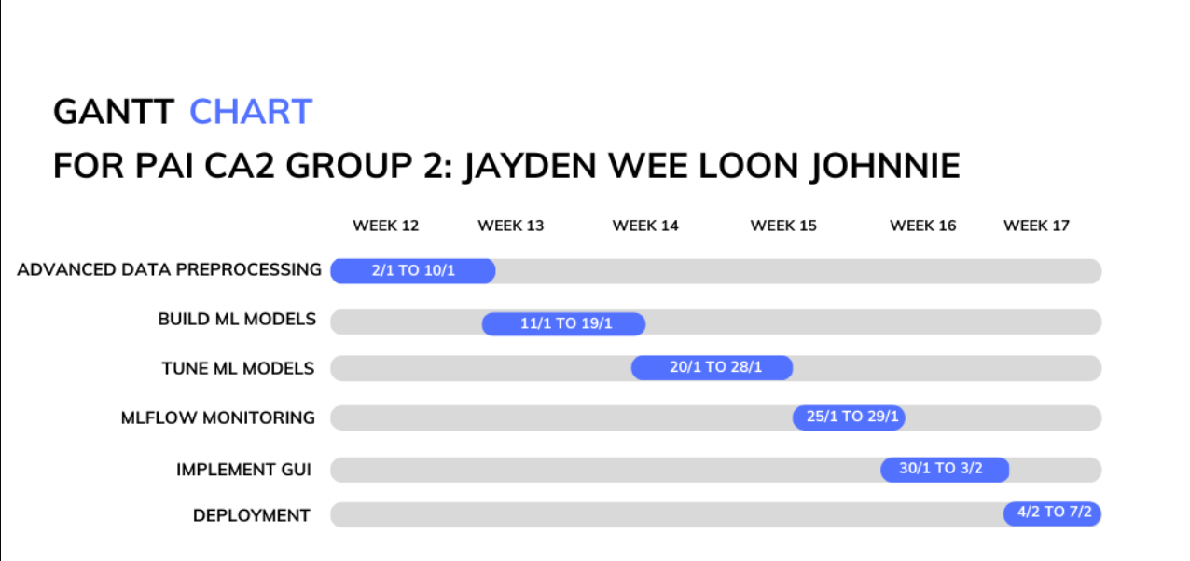
Introduction
Our objective here is to help a Taxi Company, Just Taxi, build an application that will be able to predict whether their trips are safe or dangerous

Slide 4
Week 12 & 13 Deliverables
Product Backlog
Data-Preprocessing
Outlier Detection
Feature Engineering
Addressing Multi-Collinearity Issues
Setting up MLFlow

Slide 5
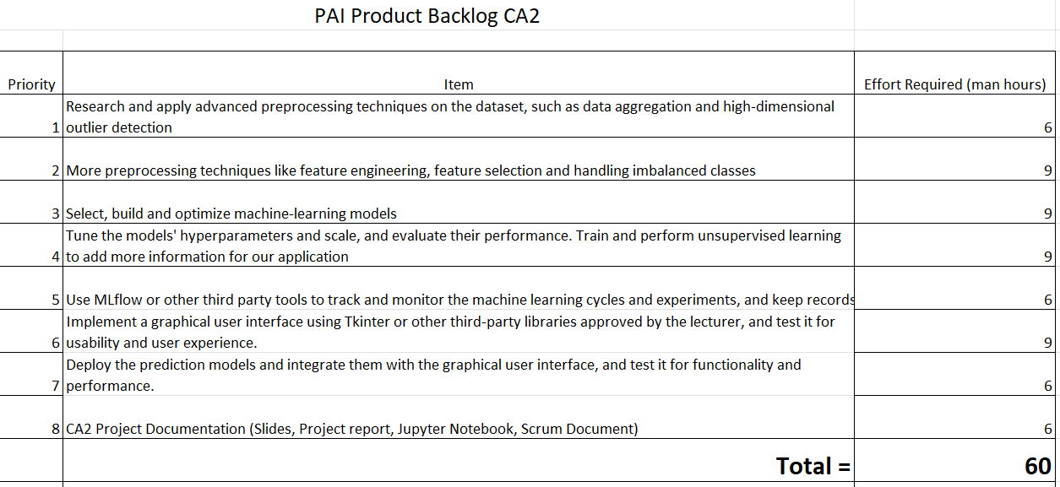
Product Backlog

Slide 6
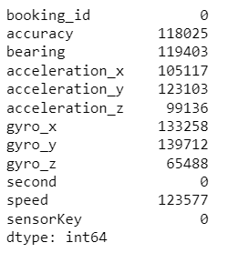
Data Preprocessing
- Imputed null values in all columns except ‘accuracy’ using IterativeImputer

Slide 7

Outlier Detection on Sensor Data
- Univariate outlier removal technique: Using boxplot and removing data outside of upper and lower fence by adjusting IQR value.
- Multivariate outlier removal technique: Using Isolation Forest algorithm to detect outliers and use domain knowledge. E.g., clipping min value of speed to 0

Slide 8
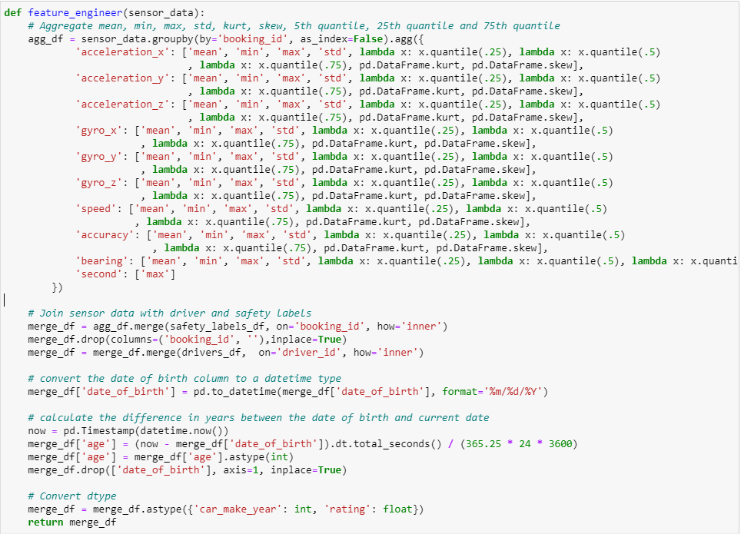
Feature Engineering
- Aggregated by booking_id
- Max for seconds
- 5th , 25th , 75th quantile, kurtosis, skewness, max, min, mean, std aggregated from remaining columns.
- Age column generated from date of birth column.
We also added net acceleration which just simply follows the equidistant formula and uses the sine value of bearing since 0 and 360 degrees have no difference but 0/360 and 180 degrees has the highest difference.
In total, we have 92 columns after feature engineering.

Slide 9
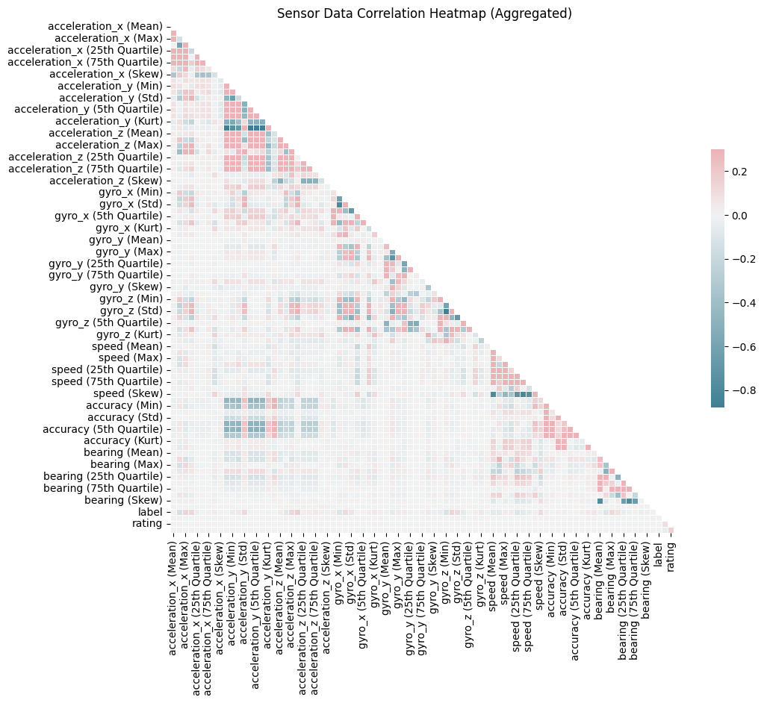
Addressing Multi-Collinearity Issues
-Dropped columns with a correlation higher than 0.6.
- The column with the highest number of correlations was dropped first, and this process is iterated.
*One column dropped at a time.
- The final dataset contained 55 columns (from the original 92).
- The final dataset only contained columns with less than 0.6 correlation with one another.

Slide 10
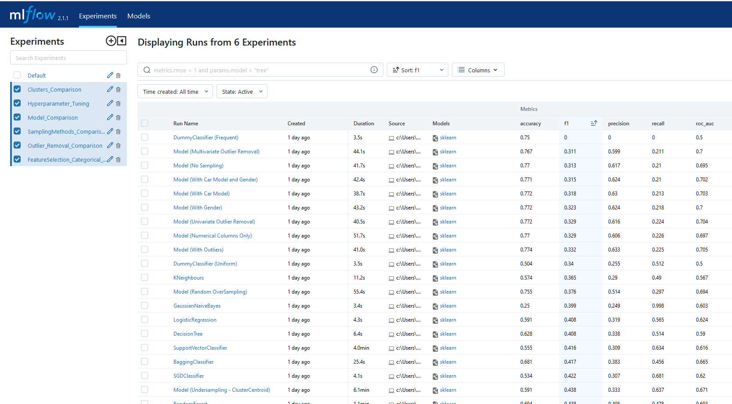
Tracking Machine Learning Cycles (MLFlow)
- MLFlow adopted for tracking machine learning sections
- MLFlow was chosen due to its ability to store valuable information such as hyperparameters, model type, and results.
- MLFlow will be used throughout the entire process.
Our MLFlow UI at the end of the project

Slide 11
Week 14 & 15 Deliverables
Feature Selection
Evaluating Outlier Removal Techniques
Testing Sampling Methods
Model Comparison
Hyperparameter Tuning

Slide 12
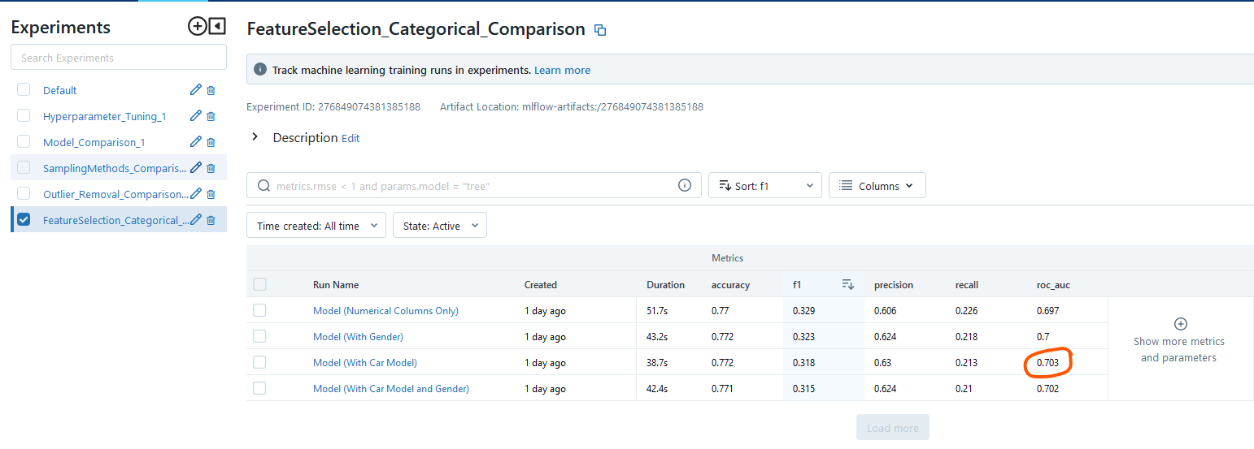

Feature Selection
- Recursive Feature Selection Cross Validation (RFECV) used on numerical columns with scoring set to F1-score. Model used is Random Forest Classifier
- There were only 5 important columns extracted from RFECV. The 5 columns are:
[ acceleration_z (Std), speed (Std), speed (Skew), bearing (Std), second (Max) ]
- We then experimented adding car model and gender manually and evaluated the performance of the model.
- Even though the model trained on only the numerical columns produced the highest F1-score, the AUC score produced is the lowest.
- The model trained on car model however produced the highest AUC score and a considerably good F1-score.
- Thus, we decided to use the dataset with the 5 numerical columns + car model when training and testing our subsequent models.

Slide 13
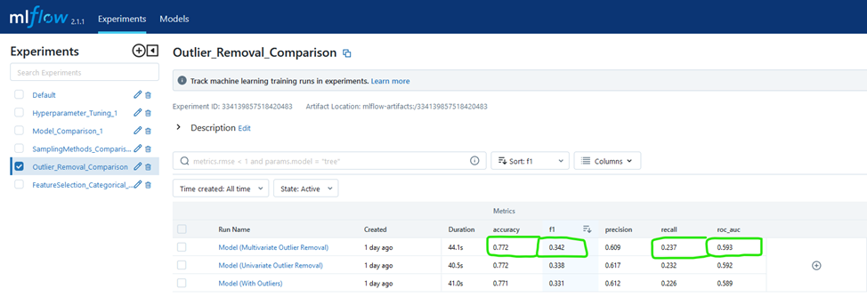
Testing Outlier Methods
- The team tested two outlier detection methods: univariate and multivariate.
- Holdout validation set of the original data (with outlier) was used. - To replicate real-life data as much as possible
- Three experiments were carried out: original outliers, univariate method, and multivariate method.
- To prevent data leakage, all training data was aggregated and split using indices.
- Multivariate outlier displays the best result.

Slide 14
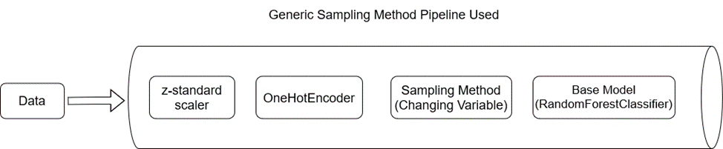
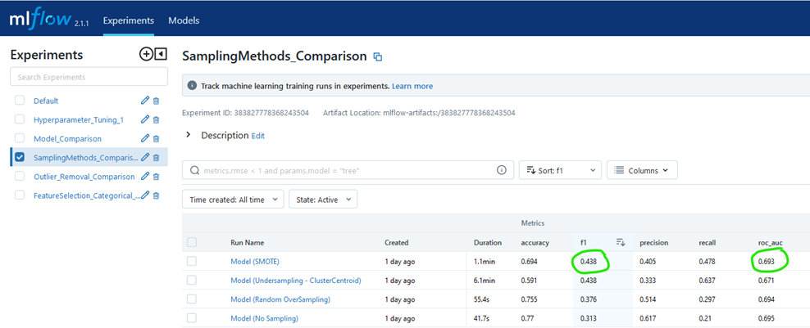
Testing Sampling Methods
- Four experiments were conducted: no sampling, under sampling with k means, random oversampling, and SMOTE with k neighbours.
- All experiments compared against original 25% holdout set (with outliers).
- SMOTE with k neighbours provided the best f1-score of 0.438.
- f1-score more favored than accuracy since it's better to be safe than sorry.

Slide 15
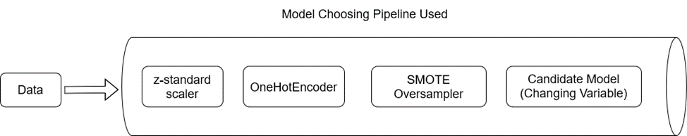
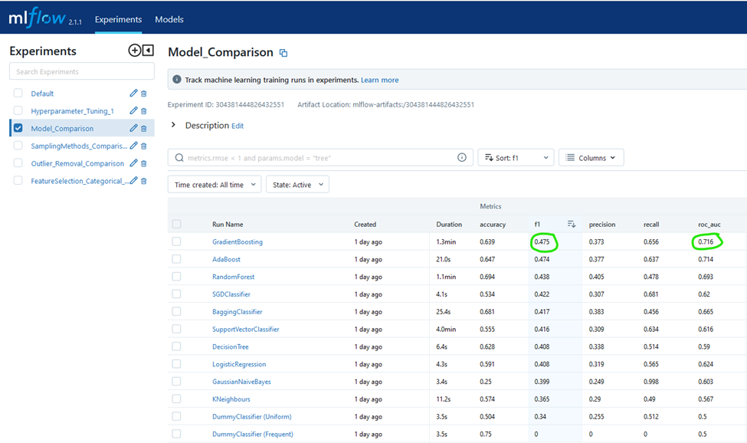
Model Comparison
- Adopted cross-validation with k-fold = 4
- Used mean f1-score to choose our model
- Tested 10 different classifiers and chose the one with the highest mean cross-validation f1-score
- Avoided overfitting by deciding the model based on cross-validation f1-score.
- Two dummy classifiers were used as comparison for model performance
- Any model with lower F1-score than dummy classifiers was considered as having extremely poor performance and not chosen as the prediction classifier.

Slide 16
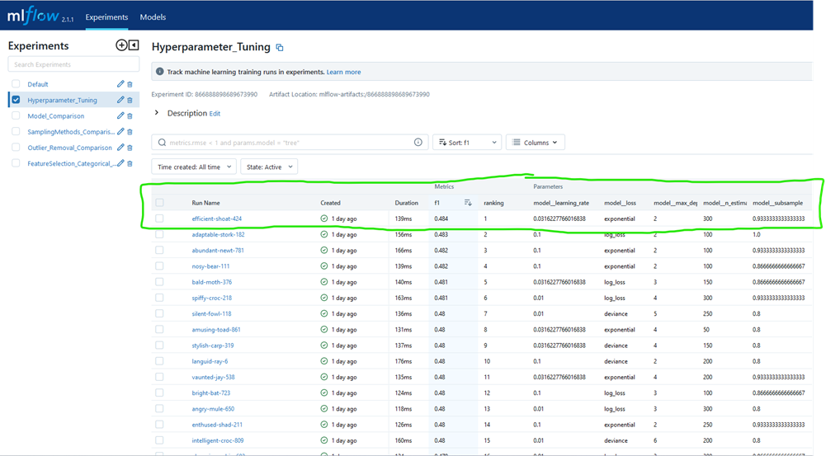
Hyperparameter Tuning
- Random hyperparameter tuning with cross-validation was chosen to tune our base model.
- 5 key hyperparameters were tuned: learning rate, n-estimators, max depth, subsample, and model loss function.
- We tune the 5 hyperparameters as it can both increase and decrease the complexity of the model and find the most optimal training configuration.
- After tuning, the best model produced an F1 score of 0.484, an improvement from before tuning (0.475).

Slide 17
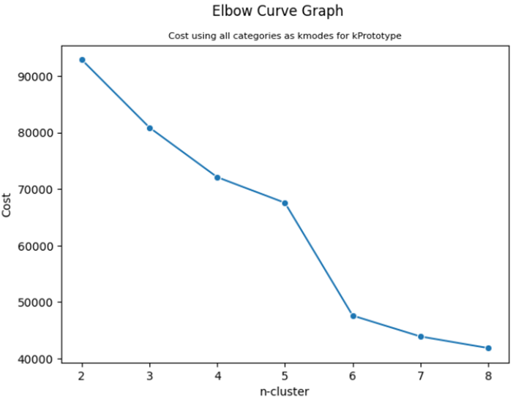
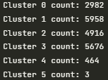
Training Unsupervised Machine Learning
- K-Prototype algorithm used to perform clustering on the dataset.
- n-cluster: 6 chosen as there is a huge drop in cost from n-cluster 5 to 6 before the gradient becomes less steep.
No. of data in the 6 clusters

Slide 18
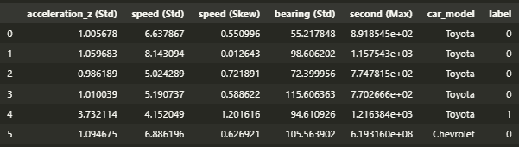
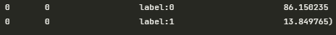
Training Unsupervised Machine Learning
Clusters
- Cluster 0: Highest % of safe trips (86%), lower acceleration standard deviation and speed skewness (characteristic of safer/careful driver)
- Cluster 4: Contains 73% dangerous trips, high % can be attributed with acceleration(std), bearing(std) and speed(std). If predicted cluster is 4, we must give a warning.
- Cluster 1: Contains 30% dangerous trips. If trips predictions are labelled as cluster 1, we can warn them in the future to drive safer.
- Cluster 5: From the sensor readings, this cluster is clearly outliers, especially in duration of trips. An explanation for this cluster could be that the sensors are faulty.
- Cluster 2 & 3: Characteristics of an average driver.

Slide 19
Week 16 & 17 Deliverables
Tkinter Application
Project Documentation

Slide 20
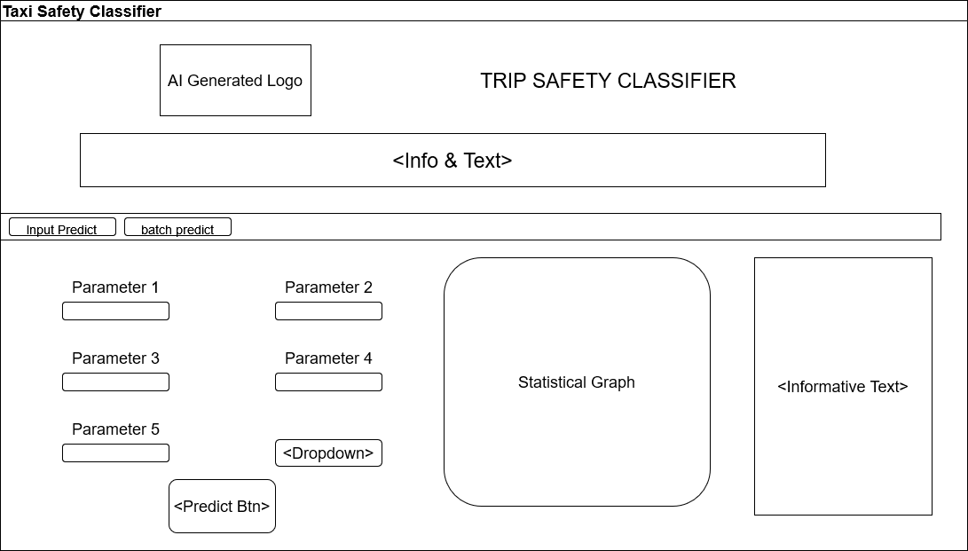
Tkinter Application – Staging Phase
- We develop a Tkinter GUI to allow users to easily make predictions without Python knowledge
- We first created a wireframe design for the application
- During development we made use of various TTK (Themed tkinter) widgets following a green forest theme.
- Tkinter grid system to allow for dynamic resizing
- Used both supervised and unsupervised models for predictions then outputs a PCA graph and analysis
Wireframe of our application

Slide 21
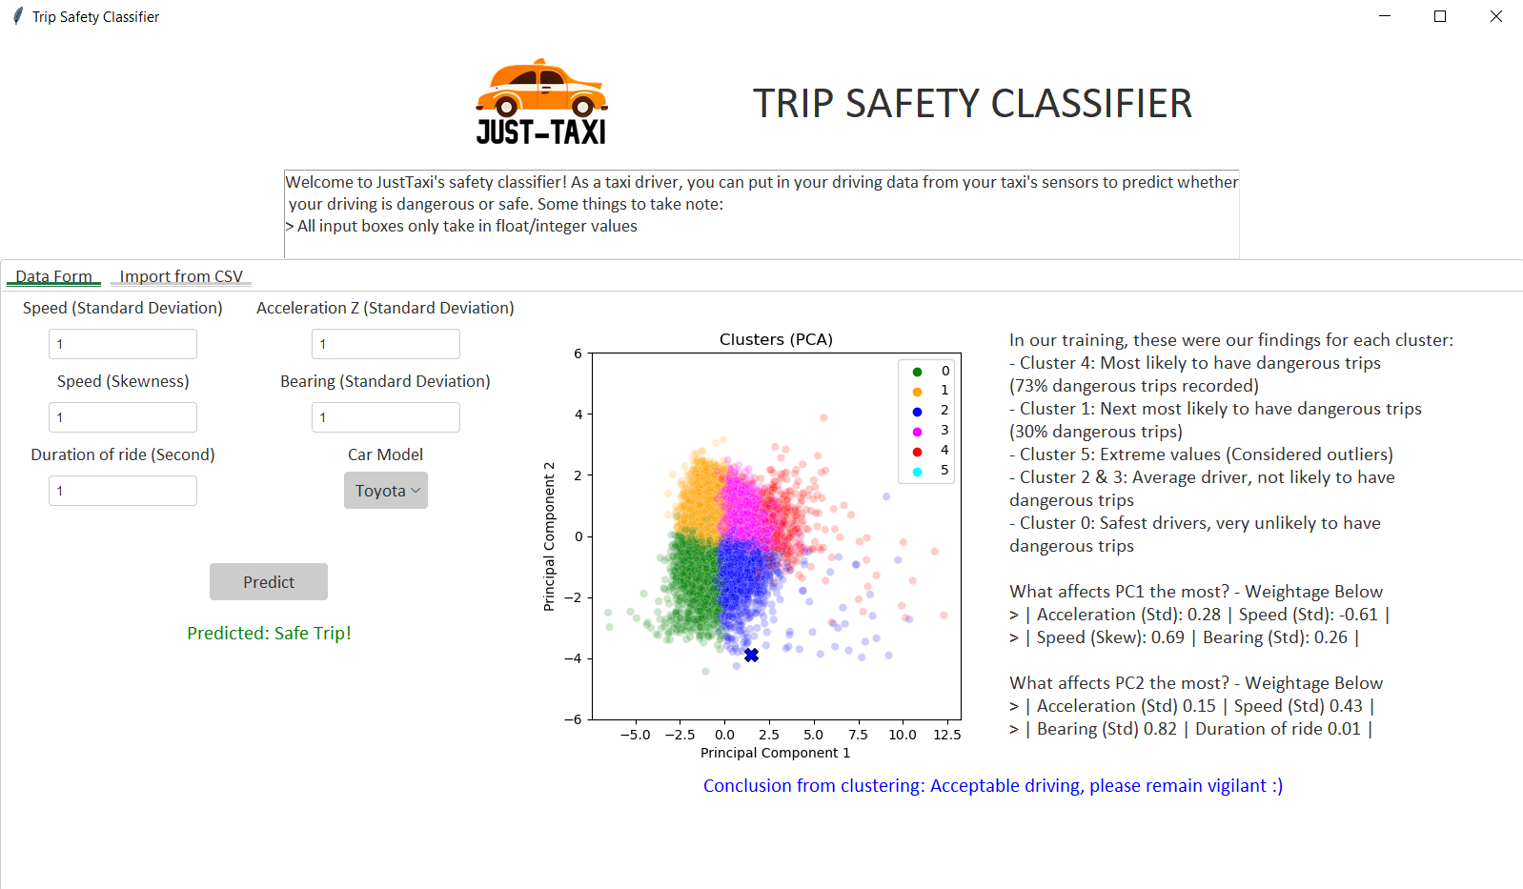
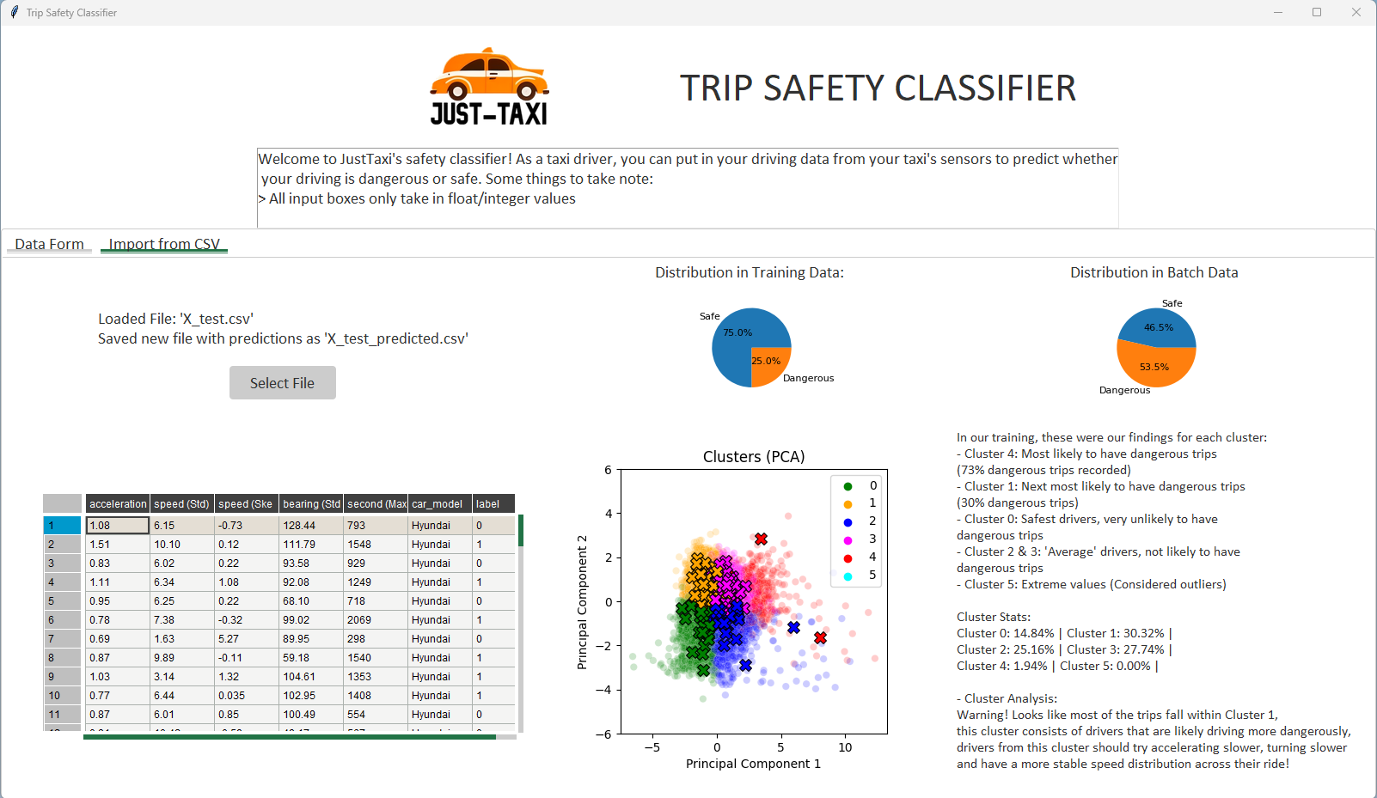
Application Overview

Slide 22
Application Data Form
- The user must first fill up the data form
We assume that this data is readily available from the backend from the taxi car sensors
Using TTK Entry widgets as well as OptionMenu for dropdown
Input validation for missing data/invalid data type(strings)/inputs out of range (ridiculous numbers)
After prediction, the user will see the Binary prediction result below the predict button for whether safe/dangerous trip

Slide 23
Application PCA Graph
- After prediction, a PCA graph is shown with their new prediction being marked with a cross using the color of their predicted cluster
- Original data points are from the data used for training
In addition, information about every cluster is displayed as well as the information on the individual PC loadings

Slide 24
Application Batch Prediction
The user first uploads a CSV file or a text file with comma separated values
Error message displayed for invalid files
Formatting should follow the example X_test.csv
After loading the file, the user will see a Pandas Table view of the dataframe
Contains the new column labels with the prediction label results
This dataframe is saved as a new csv like X_test_predicted.csv for the user to retrieve the predictions later

Slide 25
Application Batch Prediction
The user also sees Pie charts comparing the distribution of safe/dangerous trips for the Training data as well as the Imported Batch data
A similar PCA graph from earlier is displayed too
In addition, we display similar information about the clusters to provide additional context to the user about what all this means.
Based on the predictions a Clustering Conclusion about how safe/ unsafe the driving is
Based on the cluster with the most predictions from that batch

Slide 26

Application Live Demo!

Slide 27

Conclusion
Our team employed a thorough data preprocessing process, which involved data imputation, feature engineering, feature selection, data aggregation, and outlier detection.
We then utilized MLFlow to keep track of our experiments and ultimately selected Gradient Boosting as our final model after performing hyperparameter tuning.
After that, we developed of a user-friendly GUI to deploy our machine learning model. A secondary unsupervised learning model was used to analyze the inputted values by users and feedback with related statistics were returned, we then tested our application rigorously for bugs, and concluded our project.
Thanks for this cool
app bro. I can now
use AI to drive safer
Look at how happy this taxi driver is again!

Slide 28
Thank you for listening!

Slide 29
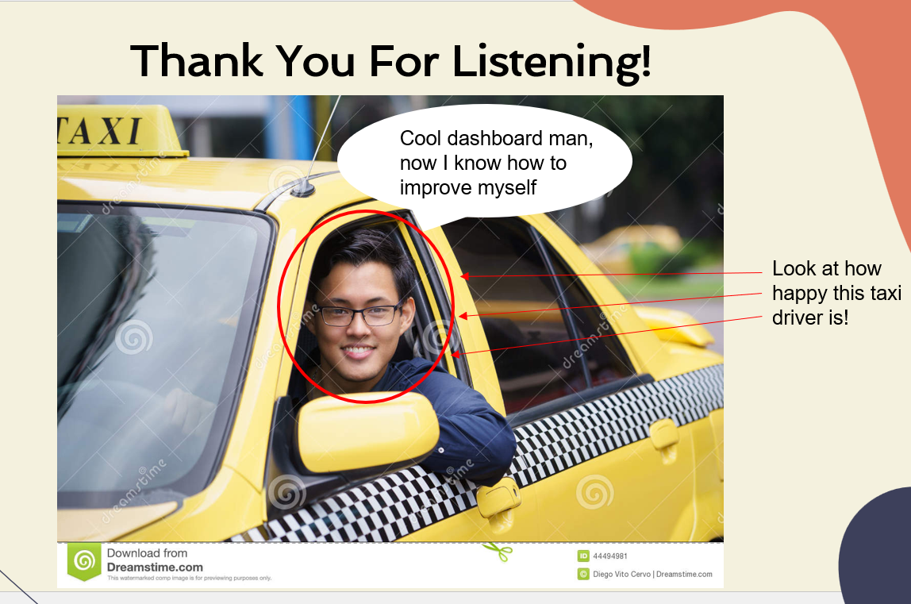
Same guy same vibes 😎
Thanks for this cool
app bro. I can now
use AI to drive safer
Sprint 1 (CA1)
Look at how happy this taxi driver is again!
Absolutely real stakeholder

